Slide 1

AWS basics and Features
Lesson 02: AWS Basics and Features
Notes:
Add instructor notes here.

Slide 2
Lesson Objectives
In this lesson, you will learn:
Introduction to AWS
Cloud Computing and Amazon Web Services
Functionality offered by AWS
The Differences that Distinguish AWS
Features of AWS service
Different AWS web services in Cloud
AWS global infrastructure
Notes:
Introduction to AWS
Cloud Computing and Amazon Web Services
Functionality offered by AWS
The Differences that Distinguish AWS
Features of AWS service
Different AWS web services in Cloud
AWS global infrastructure
This lesson is to give an Introduction on AWS basics

Slide 3
Introduction To AWS
Amazon Web Service (AWS) is a secure Cloud Service platform.
It is currently available in 190 countries with 16 geographic locations

Slide 4

2.1: Introduction to AWS Use AWS today - Examples
A large enterprise quickly and economically deploys new internal applications, such as –
HR solutions, payroll applications
Inventory management solutions,
and online training to its distributed workforce.
An e-commerce website accommodates sudden demand for a “hot” product caused by viral buzz from Facebook and Twitter without having to upgrade its infrastructure.
A pharmaceutical research firm executes large-scale simulations using computing power provided by AWS.
Media companies serve unlimited video, music, and other media to their worldwide customer base

Slide 5
2.1: Introduction to AWS AWS History
?

Slide 6
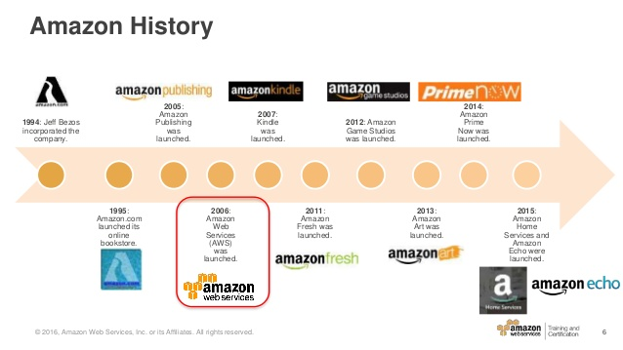
2.1: Introduction to AWS AWS History
?

Slide 7
2.1: Introduction to AWS AWS mission
Enable businesses and developers to use web services
to build scalable, sophisticated applications.
Amazon enters the Market for cloud computing and storage services.
In November 2004, the first AWS service launched for public usage: Simple Queue Service (SQS).
Amazon Web Services was officially re-launched on March 14, 2006, combining the three initial service offerings of Amazon S3 cloud storage, SQS, andEC2.
Notes:
In November 2004, the first AWS service launchedfor public usage: Simple Queue Service (SQS). ...Amazon Web Services was officially re-launched on March 14, 2006, combining the three initial service offerings of Amazon S3 cloud storage, SQS, andEC2.

Slide 8
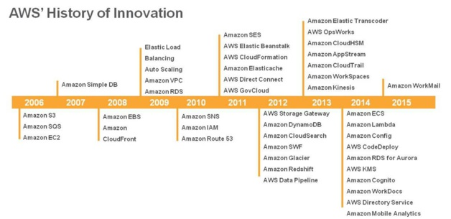
2.1: Introduction to AWS AWS mission
Notes:
AWS included the following services:
Alexa Web Information Service: (acquired in 1999)
Mechanical Turk: dividing work into many tasks for humans (2005)
Elastic Compute Cloud(EC2): computing platform (2006)
Simple Storage Service( S3 ) : storage platform (2006)
Simple Queue Service: web service for storing and queuing messages across the Internet (2007)
Flexible Payments Service: online payment platform (2007)
Simple DB: web service for running queries on structured data in real time (2007)
Persistent Storage: allows developers to earmark a storage volume online for people to save files in different file systems (2008)

Slide 9
2.2: Cloud Computing and Amazon Web Services Amazon and Cloud Computing
Amazon had spent over a decade building and managing the large-scale, reliable, and efficient IT infrastructure that powered one of the world’s largest online retail platforms.
Amazon has decentralized IT infrastructure.
Using AWS, you can demand compute power, storage, and other services in minutes .
Have the flexibility to choose the development platform or programming model .
This arrangement enabled our development teams to access compute and storage resources on demand, and it has increased overall productivity and agility.
You pay only for what you use, with no up-front expenses or long-term commitments, making AWS a cost-effective way to deliver applications.
Notes:
Amazon has a long history of using a decentralized IT infrastructure. This arrangement enabled development teams to access compute and storage resources on demand, and it has increased overall productivity and agility.
Using AWS, you can requisition compute power, storage, and other services in minutes and have the flexibility to choose the development platform or programming model that makes the most sense for the problems they’re trying to solve. You pay only for what you use, with no up-front expenses or long-term commitments, making AWS a cost-effective way to deliver applications.

Slide 10
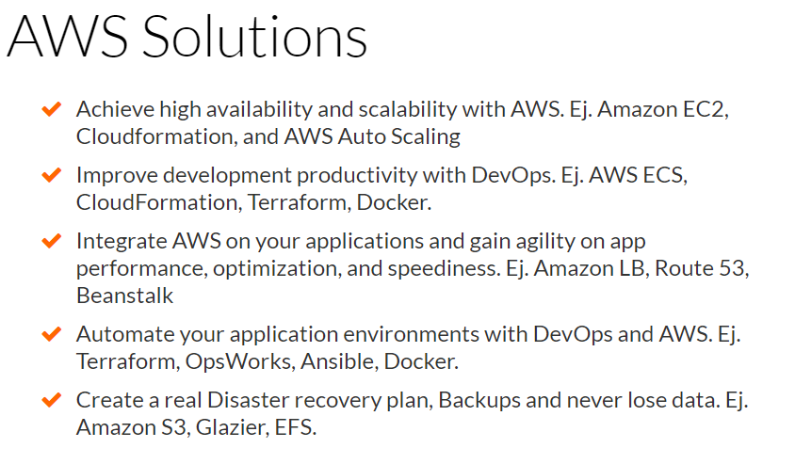
2.2: Cloud Computing and Amazon Web Services What Can I Do with AWS?
Notes:
You can run nearly anything on AWS that you would run on physical hardware:
Websites
Applications
Databases
Mobile apps
Email campaigns
Distributed data analysis
Media storage
and private networks.
The services AWS provide are designed to work together so that you can build complete solutions.
There are currently dozens of services, with more being added each year

Slide 11










2.2: Cloud Computing and Amazon Web Services AWS Customers

Slide 12
2.2: Cloud Computing and Amazon Web Services Gartner - Infrastructure-as-a-service Magic Quadrant 2013
AWS is the
overAWS is the
overwhelming market
share leader, with
more than five times
the compute capacity
in use than the
aggregate total of the
other fourteen
providers.”
aggregate total of the
other fourteen
providers.”
Notes:
“AWS is the
overwhelming market
share leader, with
more than five times
the compute capacity
in use than the
aggregate total of the
other fourteen
providers.”

Slide 13
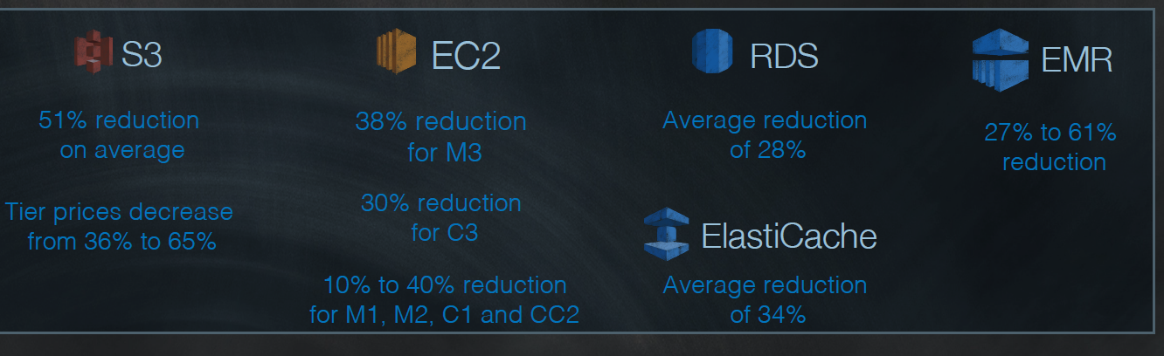
2.2: Cloud Computing and Amazon Web Services Why AWS ?
Lower costs with AWS up-front and increase savings as your
usage grows.
Amazon’s 42nd Price Reduction! Effective April 1, 2014

Slide 14
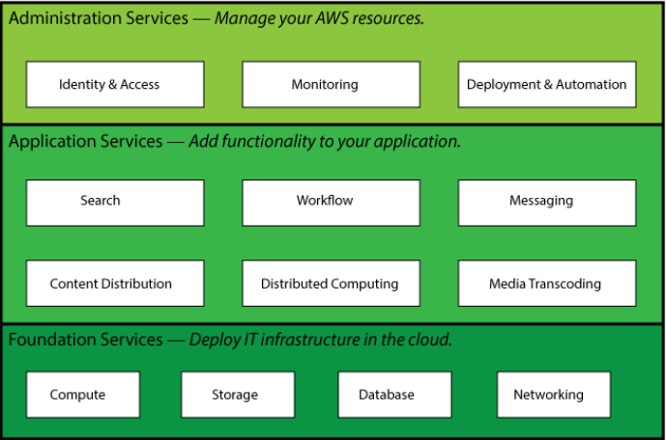
2.3: Functionality offered by AWS Functionality offered by AWS
Categories of functionality offered by AWS
Notes:
The diagram shows the categories of functionality offered by AWS. In each category, there are one or more services. For example, AWS offers five database services, each one optimized for a certain type of use. With so many offerings, you can design an AWS solution that is tailored to your needs.

Slide 15
2.4: Difference that distinguishes AWS Difference that distinguishes AWS ?
Flexible.
Cost-effective. Organizations pay only for what they use.
Scalable and elastic
Secure.
Experienced.
Notes:
AWS is readily distinguished from other vendors in the traditional IT computing landscape because it is:
Flexible. AWS enables organizations to use the programming models, operating systems, databases, and architectures with which they are already familiar. In addition, this flexibility helps organizations mix and match architectures in order to serve their diverse business needs.
Cost-effective. With AWS, organizations pay only for what they use, without up-front or long-term commitments.
Scalable and elastic. Organizations can quickly add and subtract AWS resources to their applications in order to meet customer demand and manage costs.
Secure. In order to provide end-to-end security and end-to-end privacy, AWS builds services in accordance with security best practices, provides the appropriate security features in those services, and documents how to use those features.
Experienced. When using AWS, organizations can leverage Amazon’s more than fifteen years of experience delivering large-scale, global infrastructure in a reliable, secure fashion.

Slide 16
2.5: Features of AWS Features of AWS
Flexible
AWS enables organizations to use the programming models, operating systems, databases, and architectures with which they are already familiar.
In addition, this flexibility helps organizations mix and match architectures in order to serve their diverse business needs.
Cost-effective
With AWS, organizations pay only for what they use, without up-front or long-term commitments.
Scalable and elastic
Organizations can quickly add and subtract AWS resources to their applications in order to meet customer demand and manage costs.
Notes:
Cost is one of the most complex elements of delivering IT solutions. The cloud provides an on-demand IT infrastructure that lets you consume only the amount of resources that you actually need. It is often difficult to predict requirements for the resources. As a result, we might provision too few resources, which has an impact on customer satisfaction, or we might provide too many resources and miss an opportunity to maximize return on investment (ROI) through full utilization.
In the traditional IT organization, scalability and elasticity were often equated with investment and infrastructure. In the cloud, scalability and elasticity provide opportunity for savings and improved ROI. AWS uses the term elastic to describe the ability to scale computing resources up and down easily, with minimal friction. Elasticity helps you avoid provisioning resources up front for projects with variable consumption rates or short lifetimes. Instead of acquiring hardware, setting it up, and maintaining it in order to allocate resources to your applications, you use AWS to allocate resources using simple API calls.

Slide 17
2.5: Features of AWS Features of Amazon – contd.
Secure
In order to provide end-to-end security and end-to-end privacy, AWS builds services in accordance with security best practices, provides the appropriate security features in those services, and documents how to use those features.
Experienced
When using AWS, organizations can leverage Amazon’s more than fifteen years of experience delivering large-scale, global infrastructure in a reliable, secure fashion.
Notes:
AWS delivers a scalable cloud-computing platform that provides customers with end-to-end security and end-to-end privacy. AWS builds security into its services in accordance with security best practices, and documents how to use the security features. It is important that you leverage AWS security features and best practices to design an appropriately secure application environment.

Slide 18
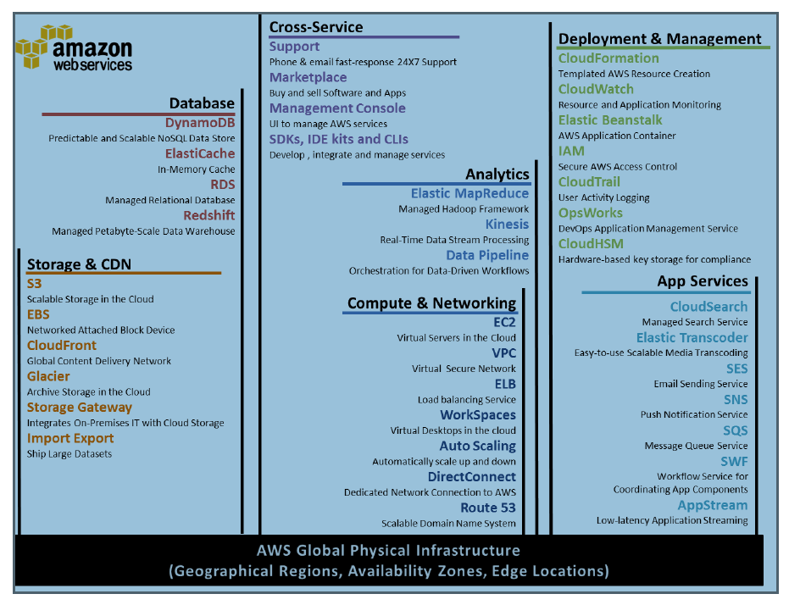
2:6: Different AWS web services in Cloud Different AWS web services in Cloud

Slide 19
2.7: Global Infrastructure Perspective on Scaling
On average, AWS adds enough
new server capacity every day
to support Amazon’s global
infrastructure when it was
a $7B business (2004)

Slide 20
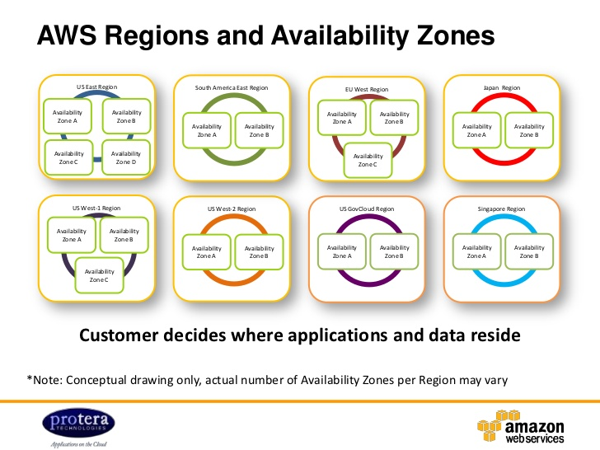
2.7: Global Infrastructure AWS ( Global Infrastructure )
Till Dec 2017
Total Regions are 16
Total Available Zones are 44
Total Edged Zones are 96

Slide 21
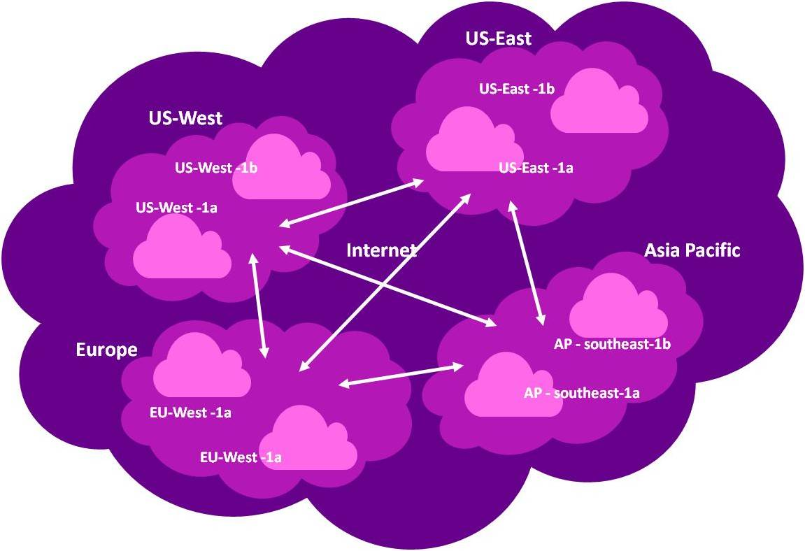
2.7: Global Infrastructure AWS ( Global Infrastructure )
Region :-
It is a Geographical area .
Each region consists of 2
or more AZ(Availability Zones)
AZ :-
Each AZ is nothing but the data center .
EL :-
Edge Location are AWS endpoint where for caching contents .

Slide 22
Summary
In this lesson, you have learnt:
Introduction to AWS
Cloud Computing and Amazon Web Services
Functionality offered by AWS
The Differences that Distinguish AWS
Features of AWS service
Different AWS web services in Cloud
AWS global infrastructure

Slide 23
Review – Questions
Question 1: Using AWS, you can demand compute power, storage, and other services in minutes .
Option 1 : True
Option 2 : False
Question 2 : _________ in AWS represents the Data center.
Notes:
Answers for the Review Questions:
Answer 1: True
Answer 2: AZ

Slide 24
Review – Questions
Question 3: _________ in AWS represents the geographical area.
Question 5: Which of the following is not an AWS service
Option 1 : EBS
Option 1 : PAAS
Option 2 : EC2
Option 3 : S3
Notes:
Answers for the Review Questions:
Answer 3 Region
Answer 4: Option 2 : PAAS

